Slide 1


Regression
Chapter 9
Dr. Abolfazl Saghafi
Assistant Professor of Statistics & Data Science
Data Science Program Director
Notes:
This is the End!

Slide 2
Bivariate Relations
Quite often we want to see how a certain variable of interest is affected by one or more other variables. For example, our weight by the amount of calorie we receive from foods!
Variable of interest: Y (= weight in the example). It is also called the response variable or dependent variable.
Predictor variable: X (= calorie in the example). It is also called the explanatory variable or independent variable.
Other examples,
(X,Y)=(Average Midterm Grade, Final Grade)
(X,Y)=(Chest Size, Weight of Bears)
Notes:
A descriptive graph to represent such pair of data is Scatter Plot in which the independent variable is mapped on the horizontal and the dependent variable is mapped on the vertical axis. Each point represent a pair of numbers for the variables.
we study the overall pattern of the plotted points.
* If there is a pattern, we should note its direction.
* We should report whether there are any outliers.

Slide 3
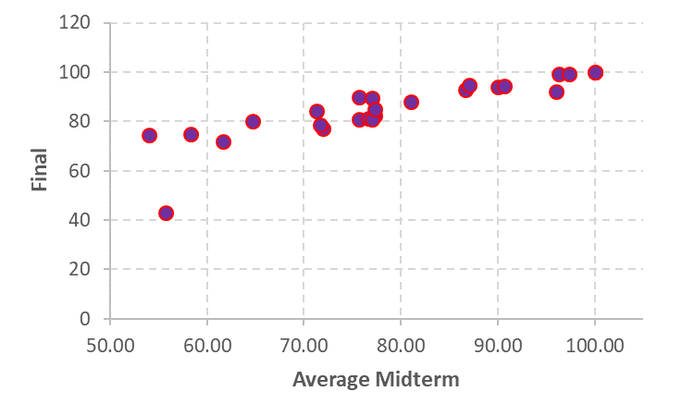
Scatterplots
A descriptive graph to represent such pair of data is Scatter Plot in which the independent variable is mapped on the horizontal and the dependent variable is mapped on the vertical axis. Each point represent a pair of numbers for the variables.
we study the overall pattern of the plotted points.
* If there is a pattern, we should note its direction.
* We should report whether there are any outliers.
Notes:
Using a sample pair of numbers (chest size, weight of bears), we can estimate a function that links the chest size to weight of bears. This function can then be used to estimate the weight for any given chest size.
There is an increasing pattern, as average midterm increases, the final grade increases. One observation is a little off the pattern. That student failed the class. Overall, it seems that average midterm grades is a good predictor of final grades.

Slide 4
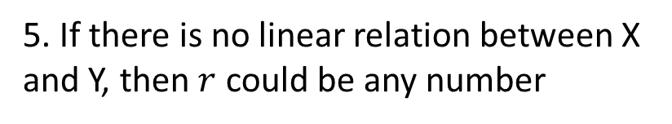
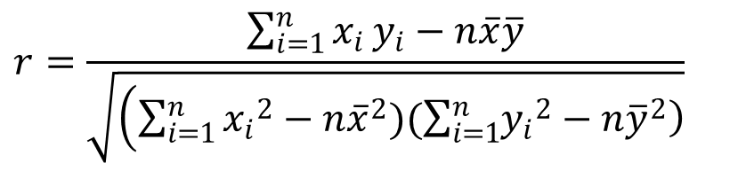
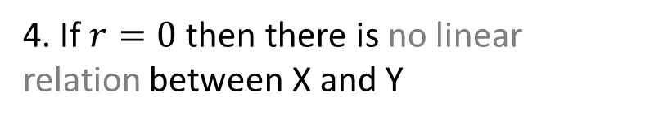
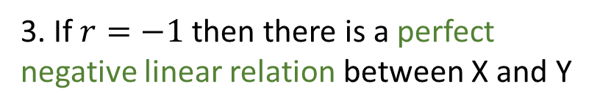
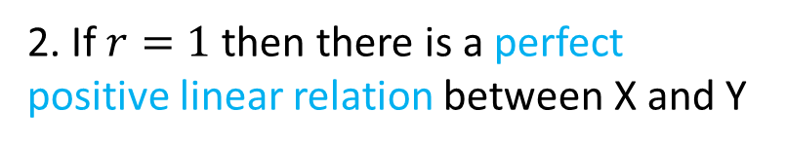
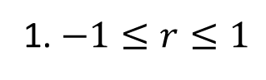
Correlation
Because visual examinations of scatterplots are subjective, we need more objective measures to check if two variables are associated.
Pearson correlation coefficient, r, is the most common statistic that measures the direction and strength of linear association.
1. $−1≤r≤1$
$$r=\frac{\sum_{i=1}^{n}{x_{i}}y_{i}−n\overline{x}\overline{y}}{\sqrt{\left(\sum_{i=1}^{n}{{x_{i}}^{2}−n{\overline{x}}^{2})(\sum_{i=1}^{n}{\left.{y_{i}}^{2}−n{\overline{y}}^{2}\right)}}\right.}}$$
2. If $r=1$ then there is a perfect positive linear relation between X and Y
3. If $r=−1$ then there is a perfect negative linear relation between X and Y
4. If $r=0$ then there is no linear relation between X and Y
5. If there is no linear relation between X and Y, then $r$ could be any number

Slide 5
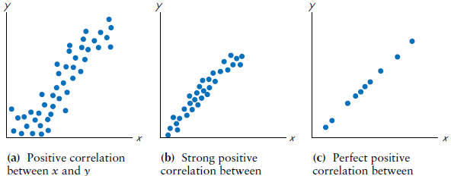
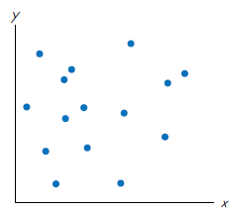
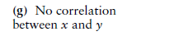
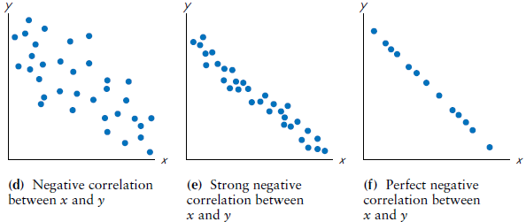
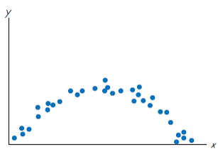
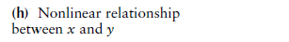
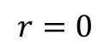
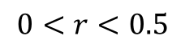
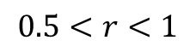
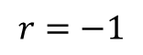
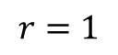
$$0<r<0.5$$
$$r=0$$
$$0.5<r<1$$
$$r=1$$
$$r=−1$$
Notes:
This is VERY important
Positive Association means, increasing x results in increase of y
Strong Linear Association is a result of dots narrowly spread along a line
Perfect Association is a results of dots spread along a long
No Association is observed when dots are spread in a box-like pattern, in this case the slope of a fitted line is zero resulting a horizontal line pattern

Slide 6
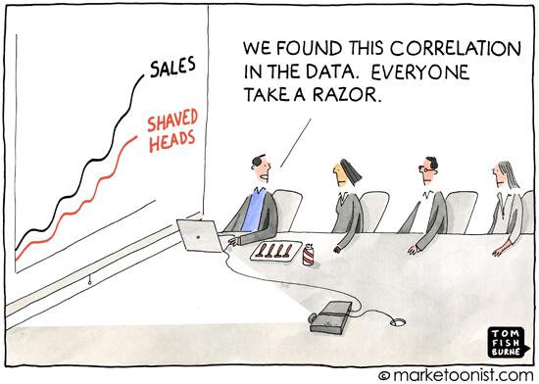
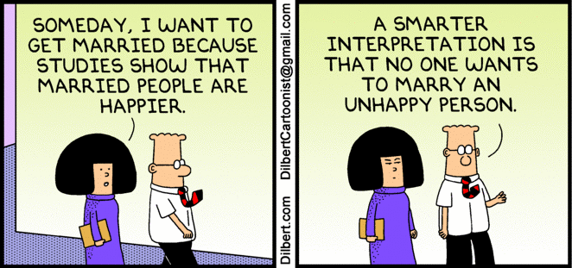
Common Errors Involving Correlation
1. Correlation does not imply causation: when two variables are found to be correlated, it is tempting to assume that this shows that one variable causes the other, but this is WRONG.
2. Reverse Causation or Reverse Causality: in a cause and effect relationship, the reverse relation is not usually correct.
Notes:
2. The faster windmills are observed to rotate, the more wind is observed to be. Therefore wind is caused by the rotation of windmills.

Slide 7
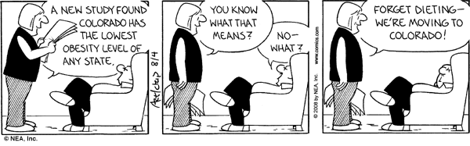
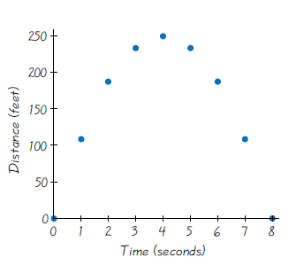
3. The common-causal variable: where a lurking variable, a hidden third variable, affects both variables and causes the correlation.
4. Linearity Assumption: An association may exist between x and y even when there is no significant linear correlation.
Notes:
3. Sleeping with one's shoes on is strongly correlated with waking up with a headache. Therefore, sleeping with one's shoes on causes headache.

Slide 8
Regression
A regression equation expresses an association between an independent variable (X) and a dependent variable (Y).
In a linear regression this association is considered to be linear, that is we assume Y = m X + b (or sometimes Y = a X + b)
b is called intercept
m is called slope and is computed as
Notes:
We can use correlation between two variables to predict the dependent variable using independent variable, the technique is called regression

Slide 9
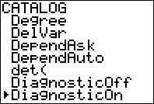
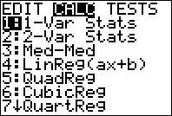
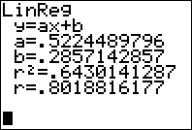
Using Calculator
First, your calculator must be set up to display the correlation.
You need to do this one time only.
Hit 2nd CATALOG (this is over the 0 button)
Go down to DiagnosticOn, hit ENTER then ENTER again
It is now set up to display correlation with a regression line
Enter the X values in one list and the Y values in another
Go to STAT > CALC > LinReg (ax+b) and hit ENTER
If your X values are in L1 and Y values are in L2, you should enter L1, L2
Hit Enter and you’ll see parameter estimates and correlation coefficient
Notes:
LEARN to use your calculator

Slide 10
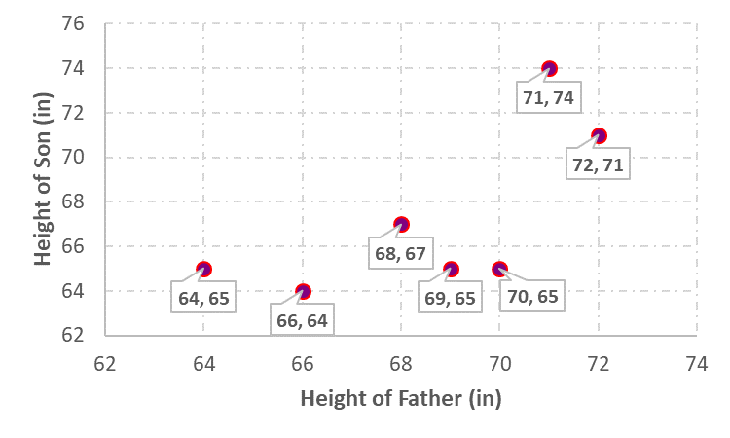
Ex1. Height
Dad’s height Son’s height
64 65
66 64
68 67
69 65
70 65
71 74
72 71
Graph the scatterplot for the given data and describe what you see.
1. Is there an association?
2. Linear or non-linear?
3. Positive or negative?
4. Weak or strong?
Use your calculator to estimate a regression line predicting height of sons using fathers’ height.
Notes:
Following the process, the results are
LinReg
y=ax+b
a=0.92 means, 1 inch increase in dad’s height results in 0.92 inch increase in son’s height
b=4.26 means, son’s height is 4.26 if dad’s height is 0!
r=0.69 showing positive, strong, linear association between x and y. 0.69 is a measure of linear association

Slide 11
Ex2. Physical Training
A study was conducted to investigate some effects of physical training on weight. Sample data are listed below, with all weights given in kilograms. Find a regression line expressing the importance of training on weight.
Pretraining: 99 57 62 69 74
Post-training: 94 57 62 69 66
Pretraining: 77 59 92 70 85
Post-training: 76 58 88 70 84
Notes:
Following the process, the results are
LinReg
y=ax+b
a=0.89 means, each 1 kg of pretraining weight shrinks to 0.89 kg after the program
b=5.87 means, post-training weight is 5.87 if pre-training weiht is 0!
r=0.98 showing positive, STRONG (near perfect), linear association between x and y

Slide 12
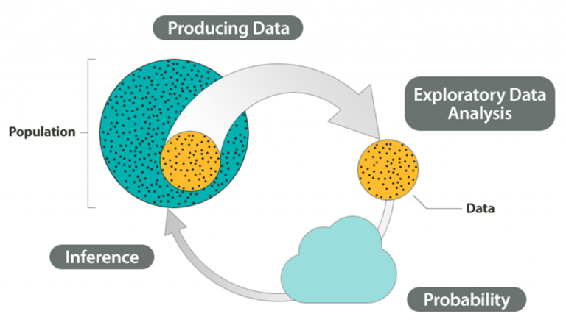
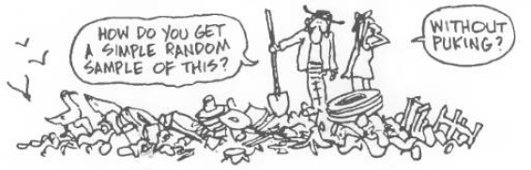
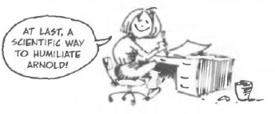
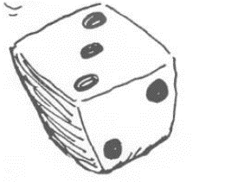
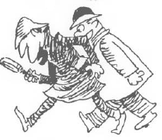

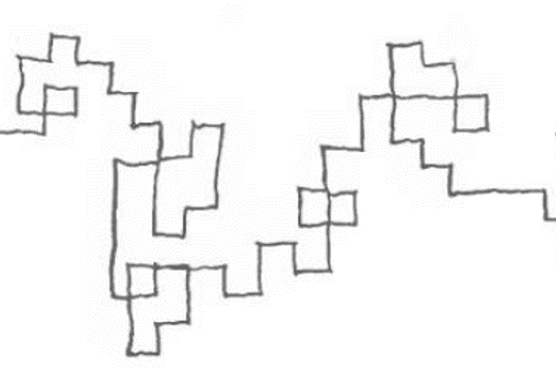
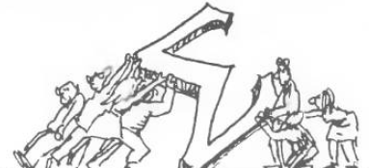
Notes:
You have come a LooOoOoOooOooong way

Slide 13

Notes:
A few MONTHS later

Slide 14

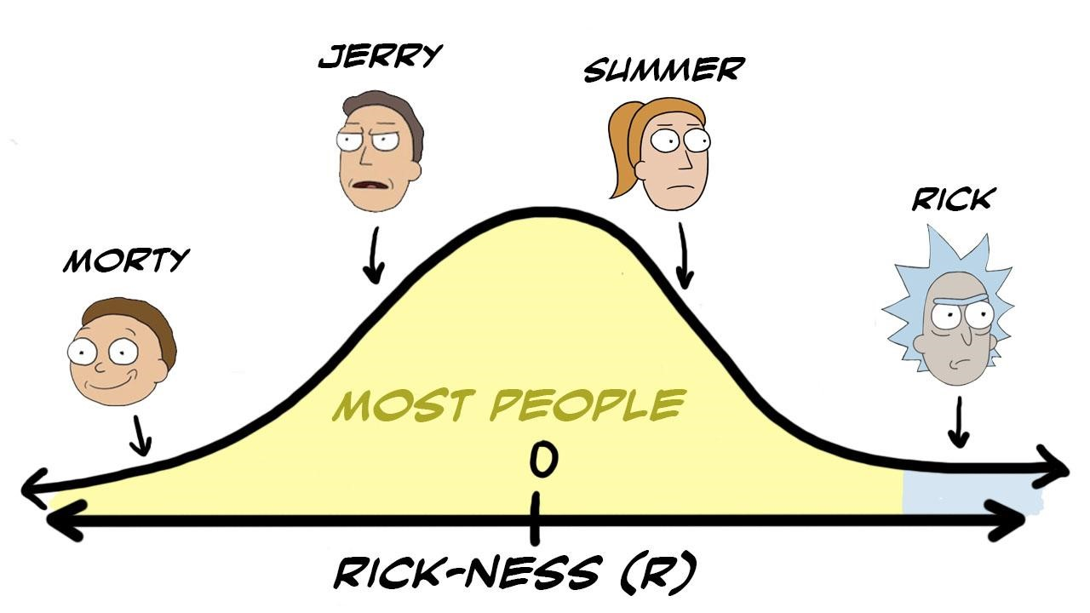
Notes:
You started a Morty and by now it’s safe to say that you’re all are at least Summer in ST310, some are Ricks ;)
A+ and A students (Ricks), consider being a MeSeeks for future Biostat students, send me an email to introduce you to the tutoring center after it’s all over

Slide 15
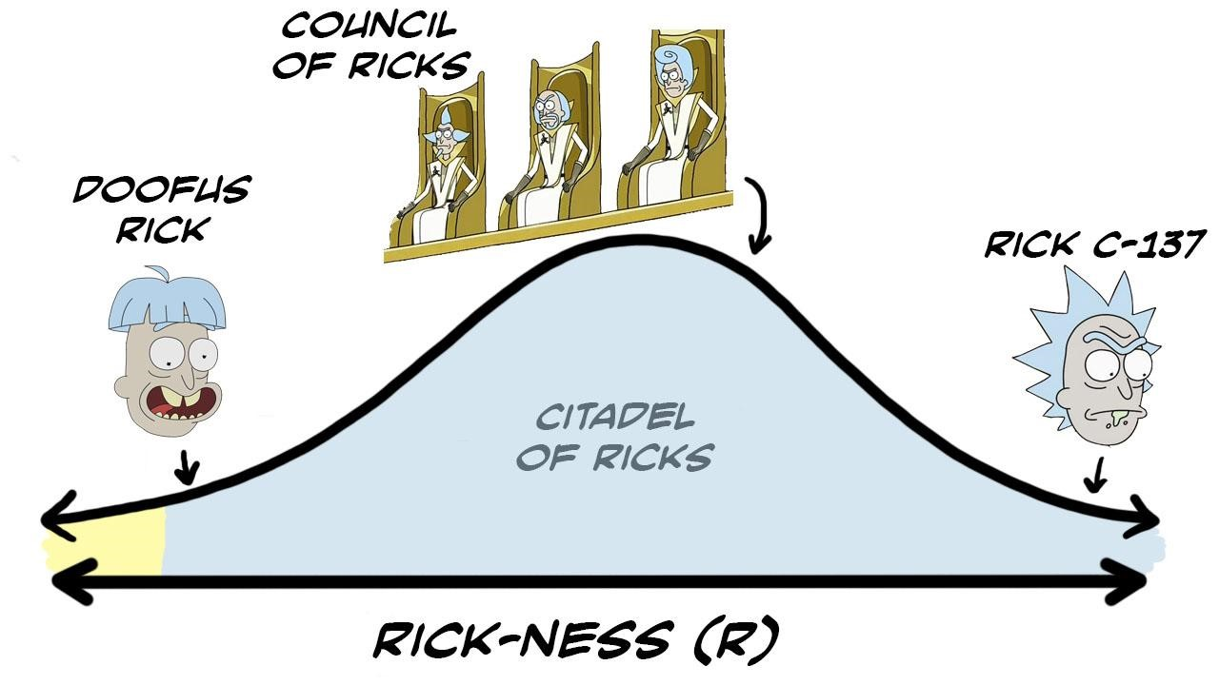
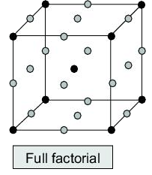
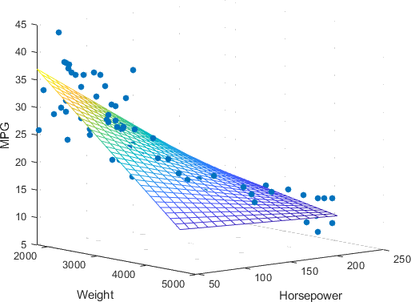
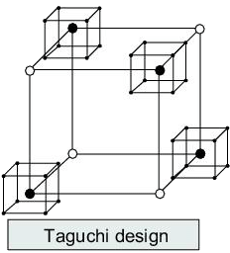


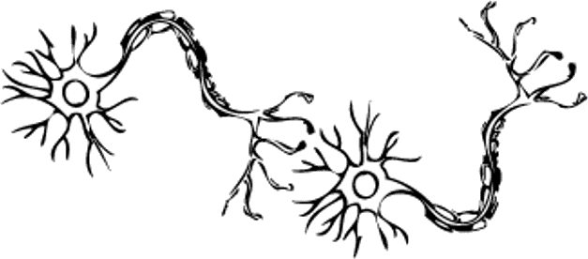
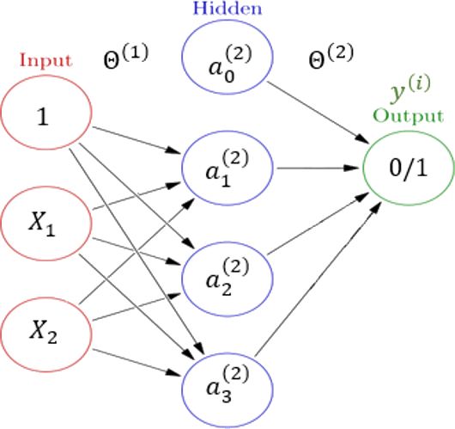

Design of Experiments
- Comparing more than two sets of data
- Investigate effects of multiple variables on outcome
- Optimal Design for experiments
Regression Analysis
- Prediction of outcome using one or many input variables
- Dummy Variables
- Model Assessment
- Coding in SAS
Stochastic Modeling
- Markov Chains
- Transition Probability
- Stationary States
- Waiting Time
- Brownian Motion
- Coding in R
Machine Learning
- Regression
- Classification
- Clustering
- Dimension Reduction
- Coding in R
Notes:
Although you’re a Rick in Biostat by the end of this course, you’re still not a Rick from Earth dimension C-137
If you wish to be the Rick of Ricks, consider taking a minor in Statistics or Data Science by signing up for courses mentioned behind the curtain ;)

Slide 16





WHAAAAT
To access evaluation form
1. Go to https://usciences.onecampus.com
2. Search for AEFIS, you will see the link
3. log into AEFIS, course evaluations will
be on your action items
1pt EXTRA to course grade
for all
If reach over 85% response
Pliiiiiz do the course evaluations
If you collected the collector badge, come see me when this situation is over, I have a small gift for you ;)
No Class on Friday
Get Ready for the Final
Final exam schedule is posted in Tests folder, check it out,
IF you have exam conflict, let me know to schedule make up

